Slide 1
Whats the intent with activites?
Android stuffs

Slide 2

Android
Notes:
’Open Source’
Java and/or C,C++,Asm

Slide 3
Activites

Slide 4
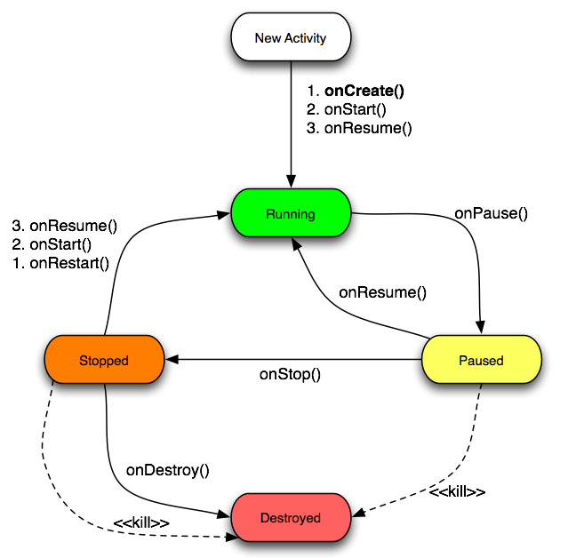
Activity lifecycle

Slide 5
Intents

Slide 6
Taking a Picture
new Intent(MediaStore.ACTION_IMAGE_CAPTURE);

Slide 7
Barcode Scanner
new Intent("com.google.zxing.client.android.SCAN");
Notes:
http://code.google.com/p/zxing/

Slide 8

Questions?

